Slide 1

Emotion Detection
Group 1: Daniel Lee, Suzy Gao, Bingquan Wu, LuLu Dong, Tushar Ponkshe

Slide 2
Table of Content
1. Choice of Models - 5 models (baseline & advanced models)
2. Parameter tuning - cross validation, PCA
3. Results and comparison - visualization
4. Conclusion & limitations

Slide 3
Baseline Model - GBM
Test set accuracy: 31%
Train set accuracy: 62%
Running time
Training: 8.42s
Predicting: 9.99s
Limitation of GBM
GBMs are more sensitive to overfitting if the data is noisy.
Training generally takes longer because of the fact that trees are built sequentially.
GBMs are harder to tune than RF. There are typically three parameters: number of trees, depth of trees and learning rate, and each tree built is generally shallow.

Slide 4
Naive Bayes Classifier
Test set accuracy: 22.4%
Train set accuracy: 22.7%
Running time
Training: 2.11s
Predicting: 6.78s
Limitations:
The strong assumption about the features to be independent which is hardly true in real life applications.
Chances of loss of accuracy.
Zero Frequency i.e. if the category of any categorical variable is not seen in training data set then model assigns a zero probability to that category and then a prediction cannot be made.

Slide 5
XGboost
Best accuracy on test set: 33%
Best accuracy on train set: 55%
---------------- With PCA ---------------------
Best accuracy on test set: 34%
Best accuracy on train set: 47.45%
Running time:
training 18m 29s, predicting 6.75s
Applied 10-fold cross validation with Parameter Tuning using Grid Search
PCA does not improve XGboost model a lot as it's already a correlation robust algorithm!
Both xgboost and gbm follows the principle of gradient boosting. There are however, the difference in modeling details. Specifically, xgboost used a more regularized model formalization to control over-fitting, which gives it better performance.

Slide 6
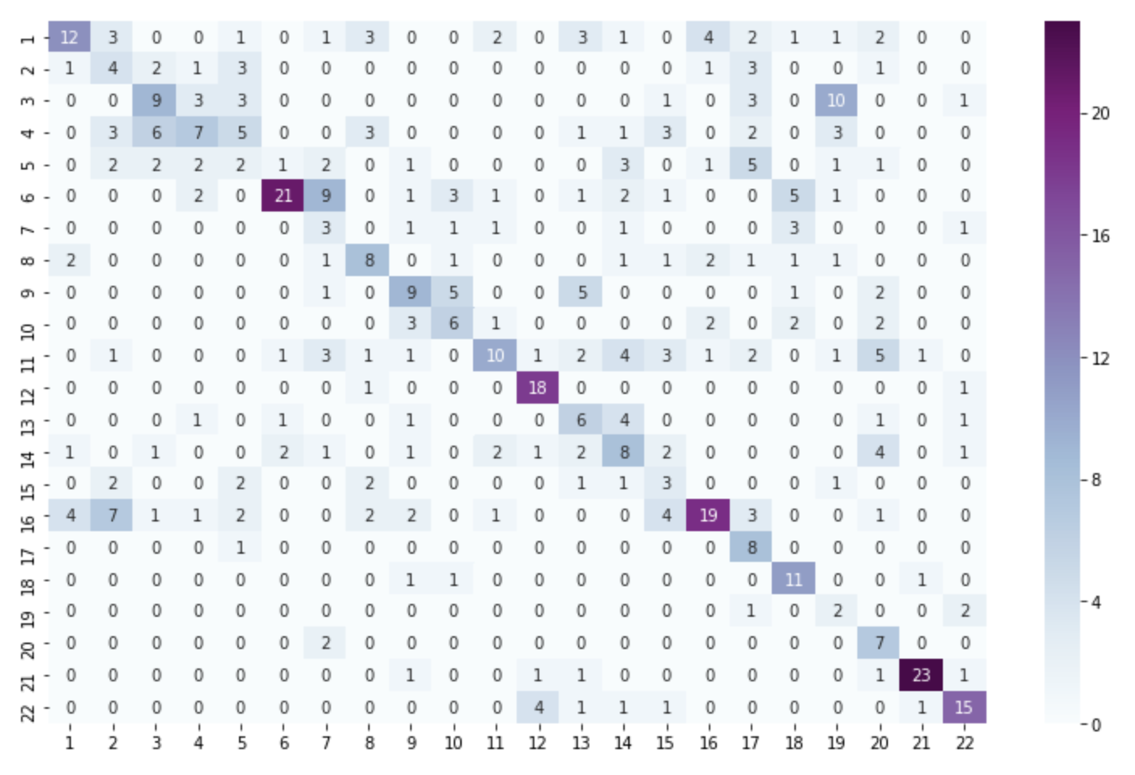
Advanced Model: SVM
Confusion Matrix
Accuracy on test set: 49%
Accuracy on train set: 99%
------------------- With PCA -------------------
- Reducing features by Keeping 94% of
the original data.
- Using only 21 features selected by PCA
-----------------------------------------------------
Accuracy on test set: 42.4%
Accuracy on train set: 47.2%
(applied 10-fold cross validation)
Actual
Prediction

Slide 7

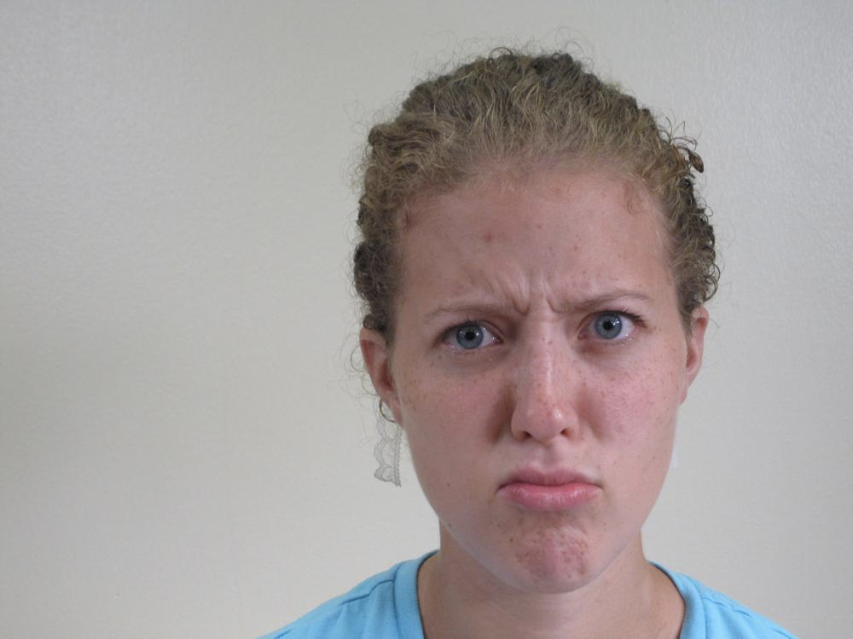
Take a guess?
Sad
Sadly Fearful

Slide 8
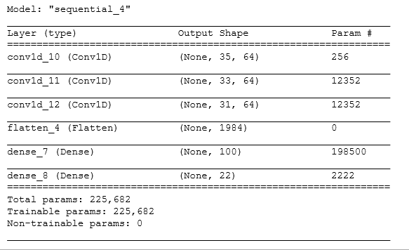
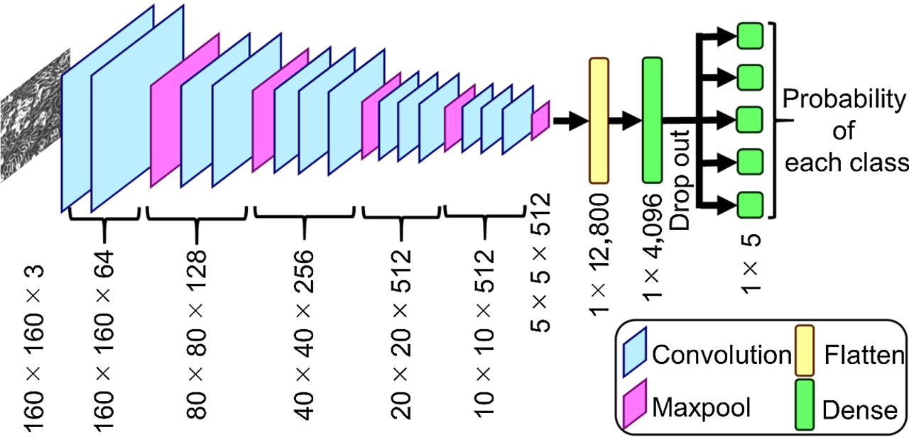
Deep Learning - CNN
Test set accuracy: 47.4%
Train set accuracy: 47.3%
Batch size: 200
Epochs: 10
Running time
Training: 17.06s
Predicting: 2.06s
Limitations:
CNNs perform poorly with less data.
CNNs have millions of parameters and with small dataset, would run into an overfitting problem because they need massive amount of data to quench the thirst.

Slide 9
Model Comparison & Conclusion
 | GBM | XGB | Naive Bayes | SVM | CNN
Training Accuracy | 62% | 47.45% | 22.9% | 47.2% | 47.3%
Test Accuracy | 31% | 34% | 20.8% | 42.4% | 47.4%
Computational Time(train) | 9.99s | 18min 29s | 6.78s | 12.6s | 17.06s
Computational Memory(train) | 480 MiB | 312.81 MiB | 497 MiB | 462.5 MiB | 574.51MiB
Test running cost | 8.42s | 6.57s | 4.4s | 1.14s | 2.06s

